Slide 1
ART4320 Photography II Color Analysis Project Student Name: Student 3
Due date:
Students need to submit their 3 photos, 3 pie charts, and 3 color wheels.
Please delete instructor’s examples before submissions.
1 Monochromatic photo, 1 pie chart, 1 color wheel
1 Analogous photo, 1 pie chart, 1 color wheel
1 complimentary photo, 1 pie chart, 1 color wheel

Slide 2
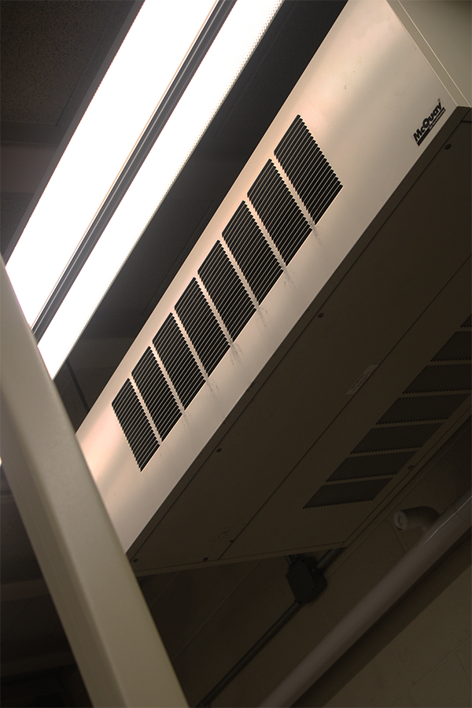
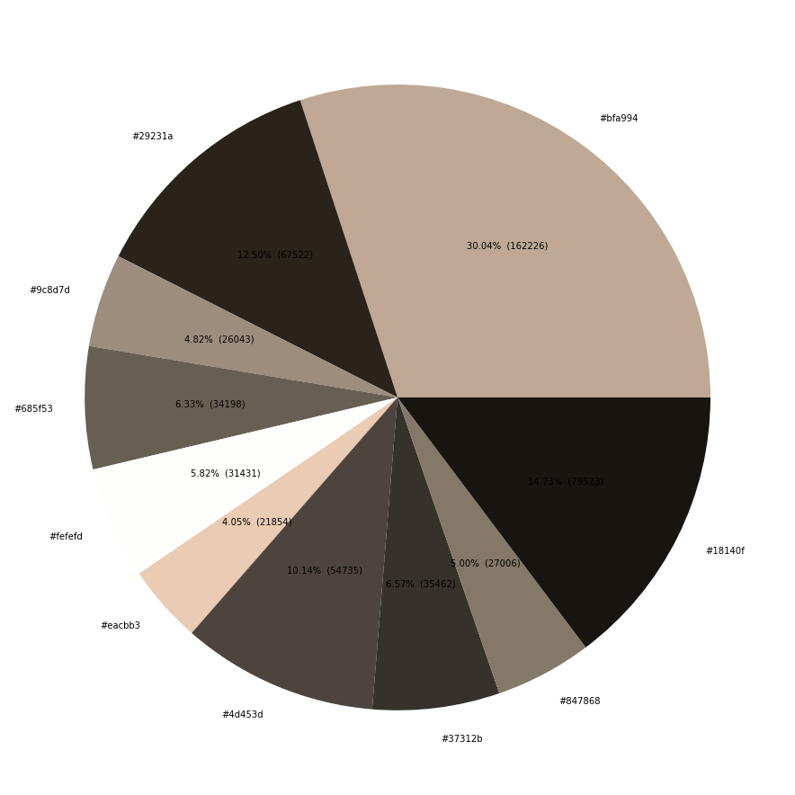
1. Monochromatic
Explain color harmony with color combination: Monochromatic color scheme with brown tones.
Write 5 hex colors with percentages: #bfa994 (30.04%), #18140r (14.73%), #eachbb3 (4.05%), #fefefd (5.82%), #685f53 (6.33%)
Which color is the most used? #bfa994 (30.04%)
What is the brightest color? #fefefd (5.82%)
What is the darkest color? #18140r (14.73%)

Slide 3
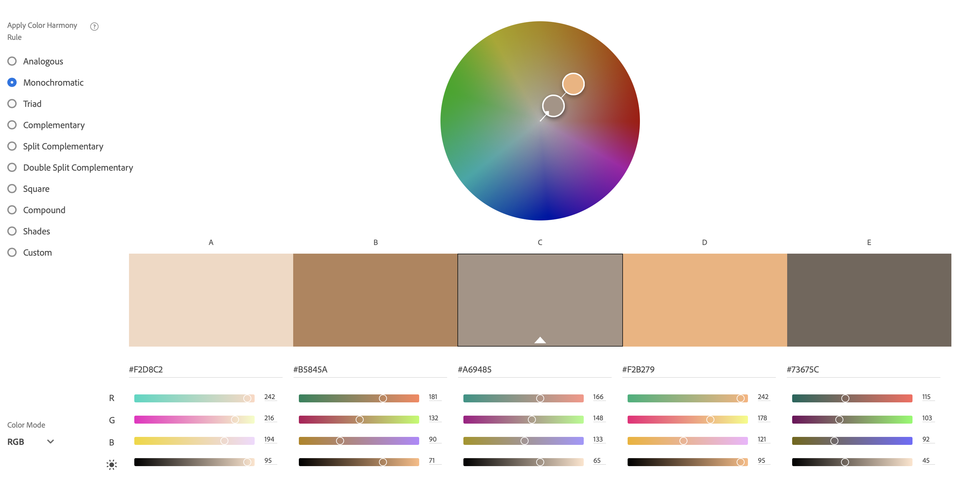
Improvement plan based on color analysis
6. I think this picture has an appropriate balance of light tones and dark tones when compared to my other pictures. I think I could improve the color harmony of the picture by taking out the white color that the light is emanating. Without the light, I think the color could have maybe been a yellowish-brown.

Slide 4
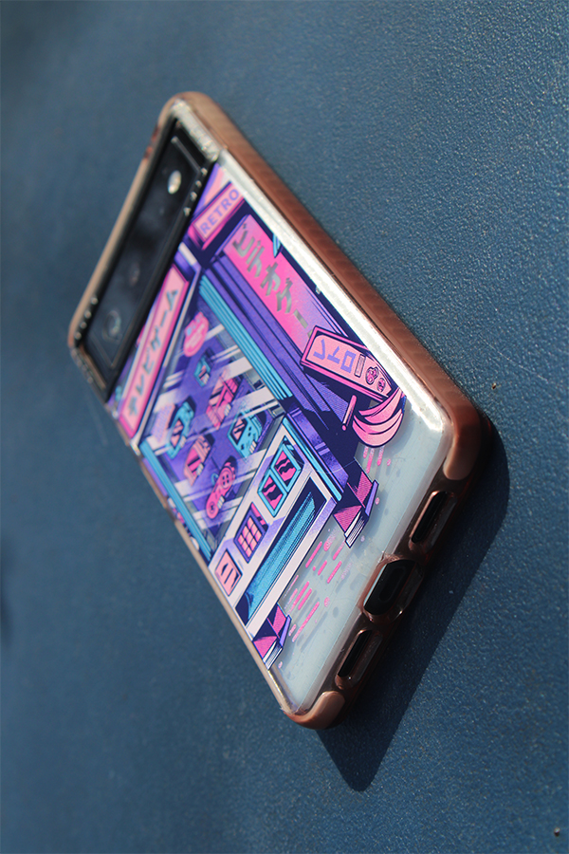
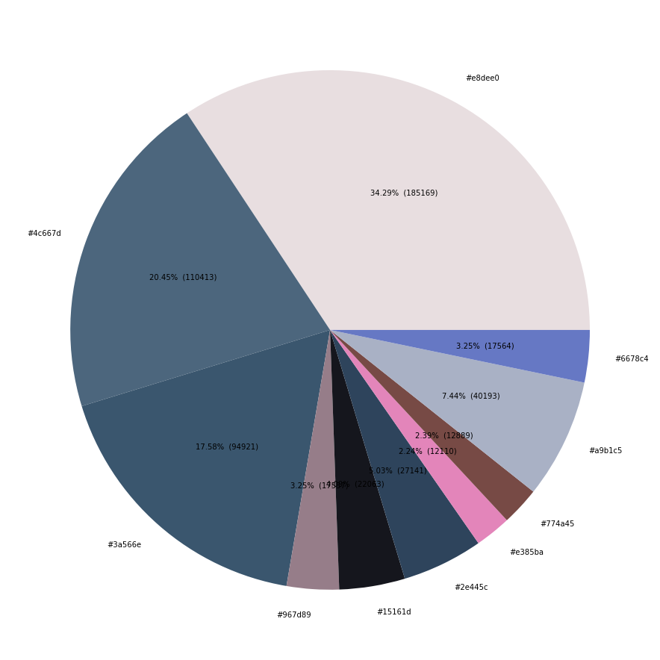
2. Analogous
Explain color harmony with color combination: Analogous color scheme with tones of blue and purple.
Write 5 hex colors with percentages: #4c667d (20.45%), #967d89 (3.25%), #ae385ba (2.24%), #a9b1c5 (7.44%), #6678c4 (3.25%)
What is the color of the main subject? (color and percentage) #e8dee0 (34.29%)
What are analogous colors (color and percentage)? #4c667d (20.45%), #6678c4 (3.25%)
What is the colors which are not analogous (color and percentage)? #e8dee0 (34.29%), #ae385ba (2.24%)

Slide 5
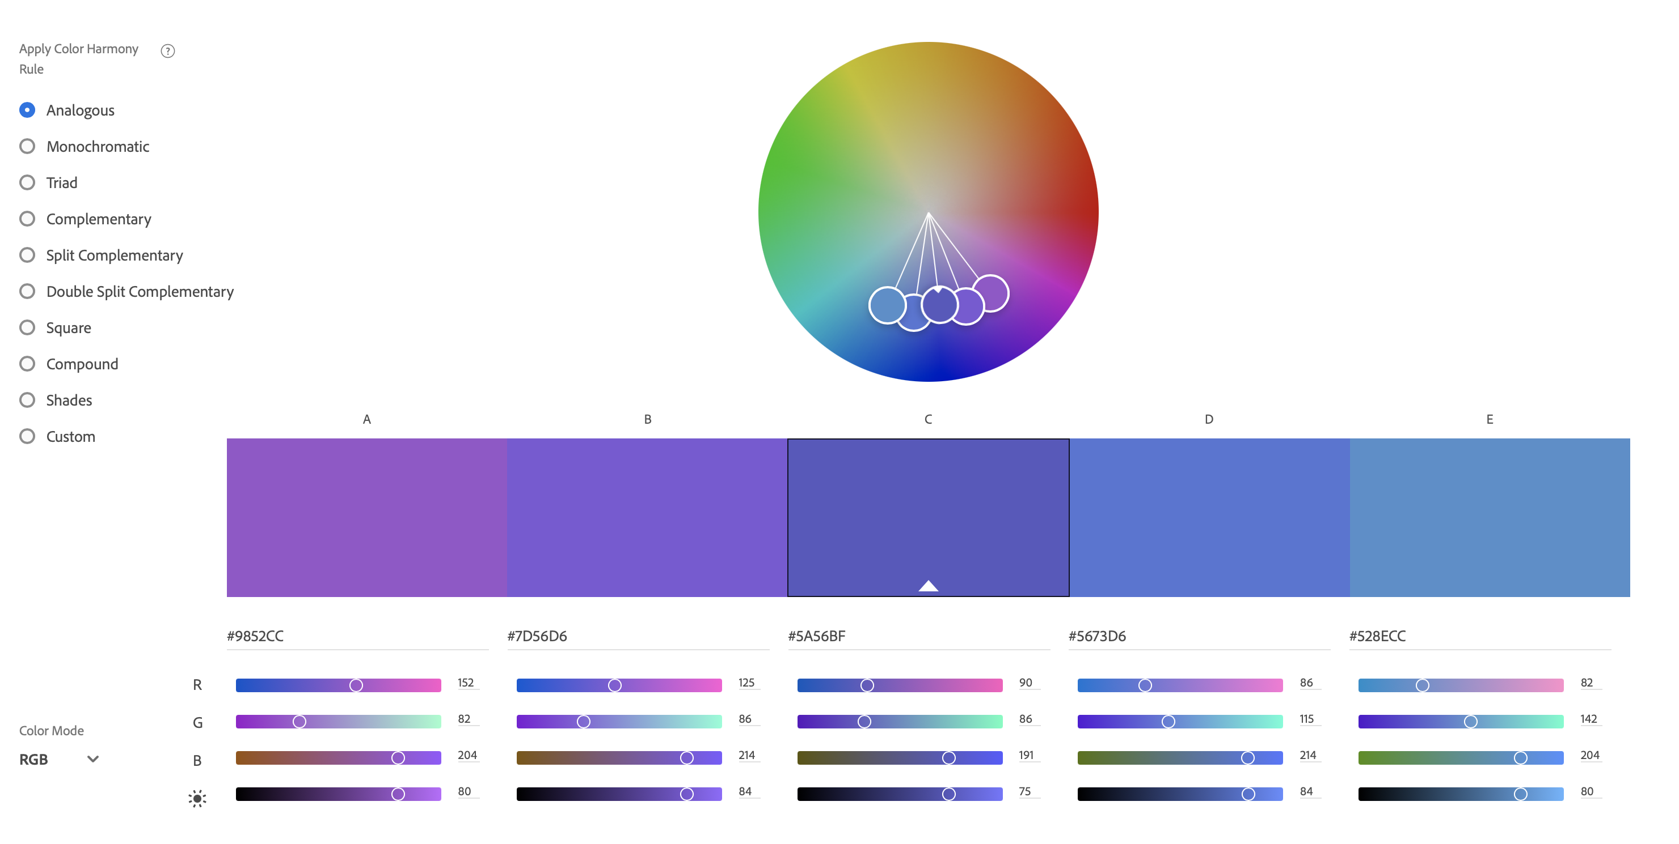
Improvement plan based on color analysis
6. Something I didn’t realize would happen when I took this picture was the overwhelming presence of the brown colors. I was almost certain that the analogous purple and blue colors would make up for most of the color percentage in the pie chart, but I was wrong. I think I would have improved the color harmony by changing the subject altogether or removing my phone from the case to partially improve the presence of the brown tones.

Slide 6
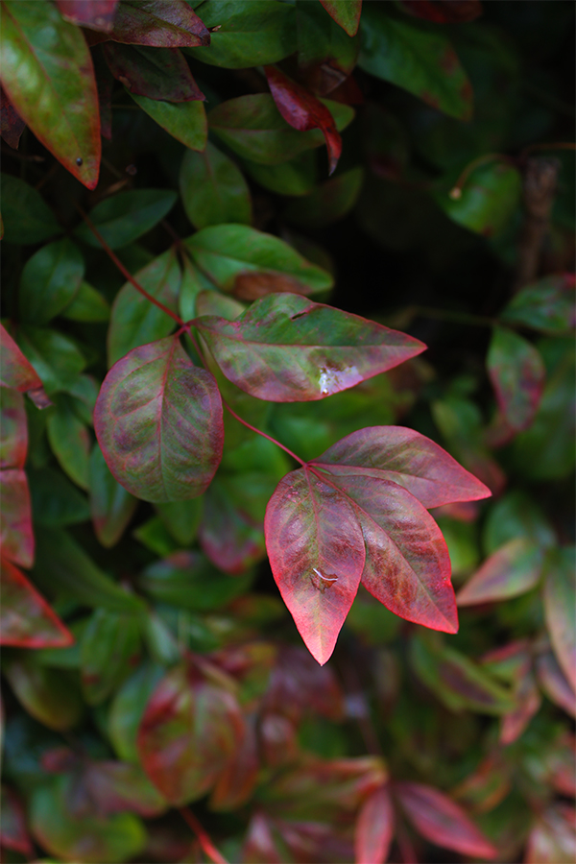
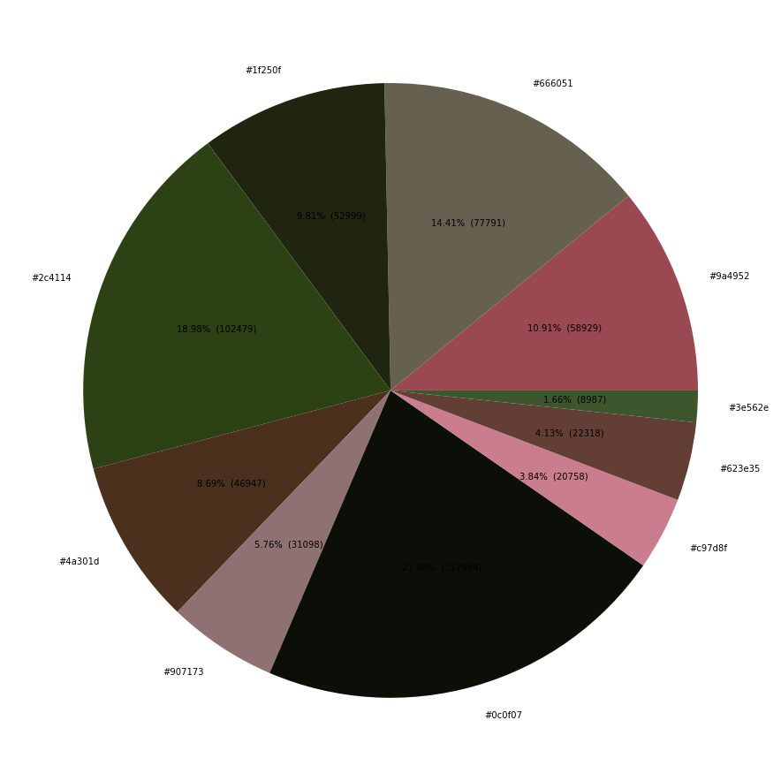
3. Complementary
Explain color harmony with color combination: complementary color scheme with reds and greens.
Write 5 hex colors with percentages: #9a4952 (10.91%), #c97d8f (3.84%), #2c4114 (18.98%), #1f250f (9.81%), #907173 (5.76%)
What is the color of the main subject? (color and percentage) #9a4952 (10.91%)
What are complementary colors (color and percentage)? #2c4114 (18.98%), #9a4952 (10.91%)
What is the colors which are not complementary (color and percentage)?#0c0f07 (21.80%), #c97d8f (3.84%)

Slide 7
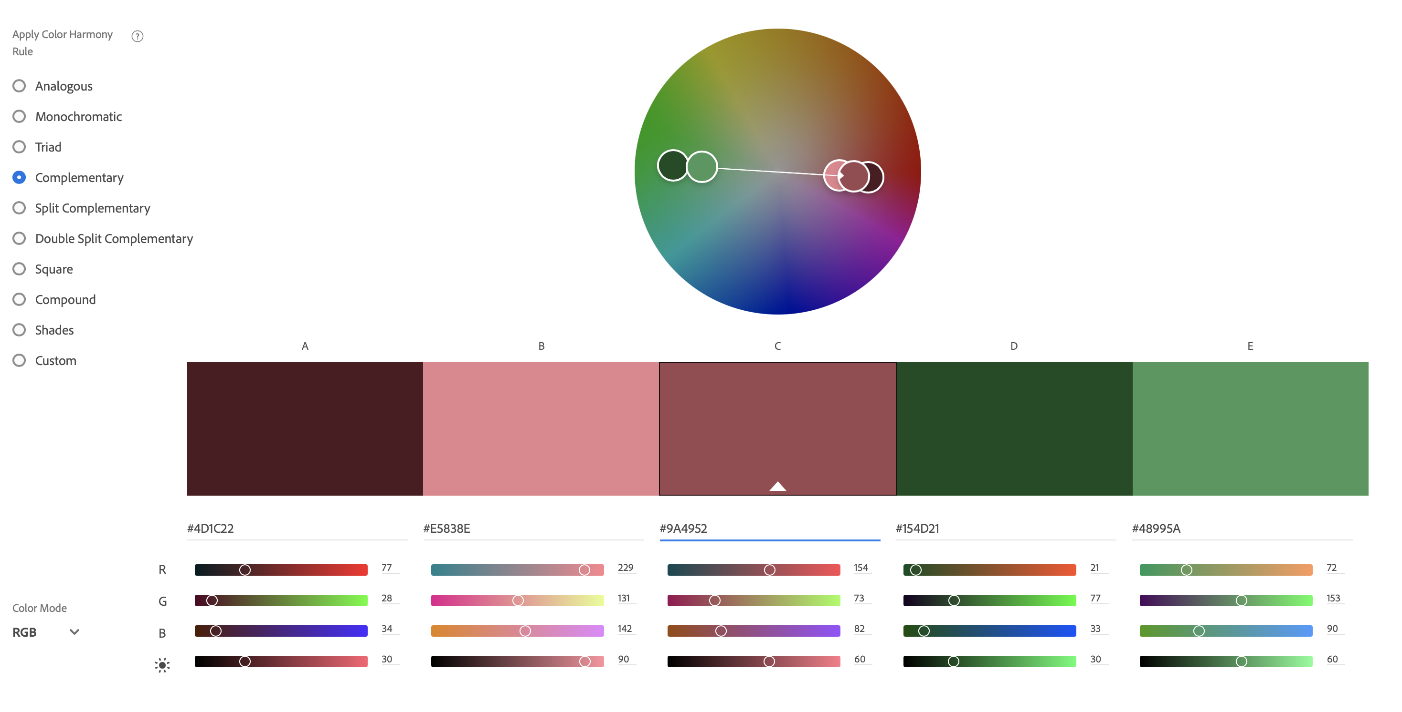
Improvement plan based on color analysis
6. The complementary color of the main subject is red and green, which are direct complements in the color wheel. If I could retake this picture, I probably would have done my best to reposition the camera to prevent black from being the most overwhelming color in the color wheel.
7. I think the color wheel and pie chart was a very interesting part of this project and wouldn’t be opposed to utilizing Python again. Overall, I generally find projects involving color theory appealing and think projects that utilize this aspect of art would be fun to do.

